Slide 1
B18 Probton
Review Date:
July 4, 2024 Review Version:
Schematic Review
ASIC Solution for Optical Probe Station
Discord name | Affiliation | Experience | Role
timlam0531 | HKUST, Hong Kong | Hobbyist | Team lead
abraaaar | Toronto Metropolitan University, Toronto | Undergraduate student | Team member
belkacem | University of Tlemcen, Algeria | PhD | Team member
nitin_i | University of California, Santa Barbara | AMS Design Engineer | Team member
rezasetiabekti8375 | University College Dublin, Ireland | Master student | Team member
ashmita1509 | University College Dublin, Ireland | Master student | Team member
vik_lyn_ | University of Waterloo | Undergraduate student | Team member
anna_b75_06065 | None | Hobbyist | Team member
CadMiuM#9906 | HKUST, Hong Kong | Undergraduate student | Team member
Looking for members |  |  | Mixed Signal

Slide 2
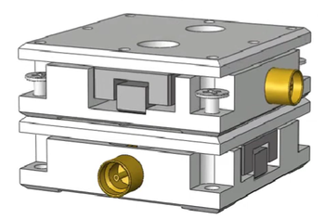
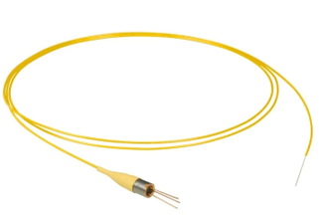
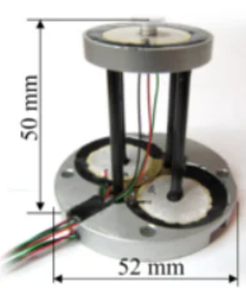
Design Objective:
Intended use:
Deliver low-latency direction indicators and signal intensity data to drive motorized alignment hardware.
Extract alignment direction using voting filter while automatically isolating and discarding corrupt signal data.
MEMS
Actuator [2]
XY-Stage [1]
Photodetector
Thorlabs FDSP625 Pigtailed Si Photodiode
Buzzer-Scanner (Wang et al. 2013)
Photodetector
Thorlabs FDSP625 Pigtailed Si Photodiode
Link: https://doi.org/10.1016/j.ohx.2022.e00317
Key Specifications:
Sensitivity: 25.0 nm/V
Resolution:
Backlash: 160 – 195 nm
Step error: ~ 7%
Link: https://www.thorlabs.com/thorproduct.cfm?partnumber=FDSP625
Key Specifications:
Spectral Band: 320 nm to 1000 nm
Response Speed: 700 ps rise/fall time
Noise: 0.01 nA dark current
Link:
https://doi.org/10.1088/0957-4484/24/45/455503
Key Specifications:
XY Range: 5 µm
Nonlinearity: 2.11% X / 2.73% Y
Noise / Resolution: ~0.06 nm
Resonance: ~360 Hz (X/Y)

Slide 3
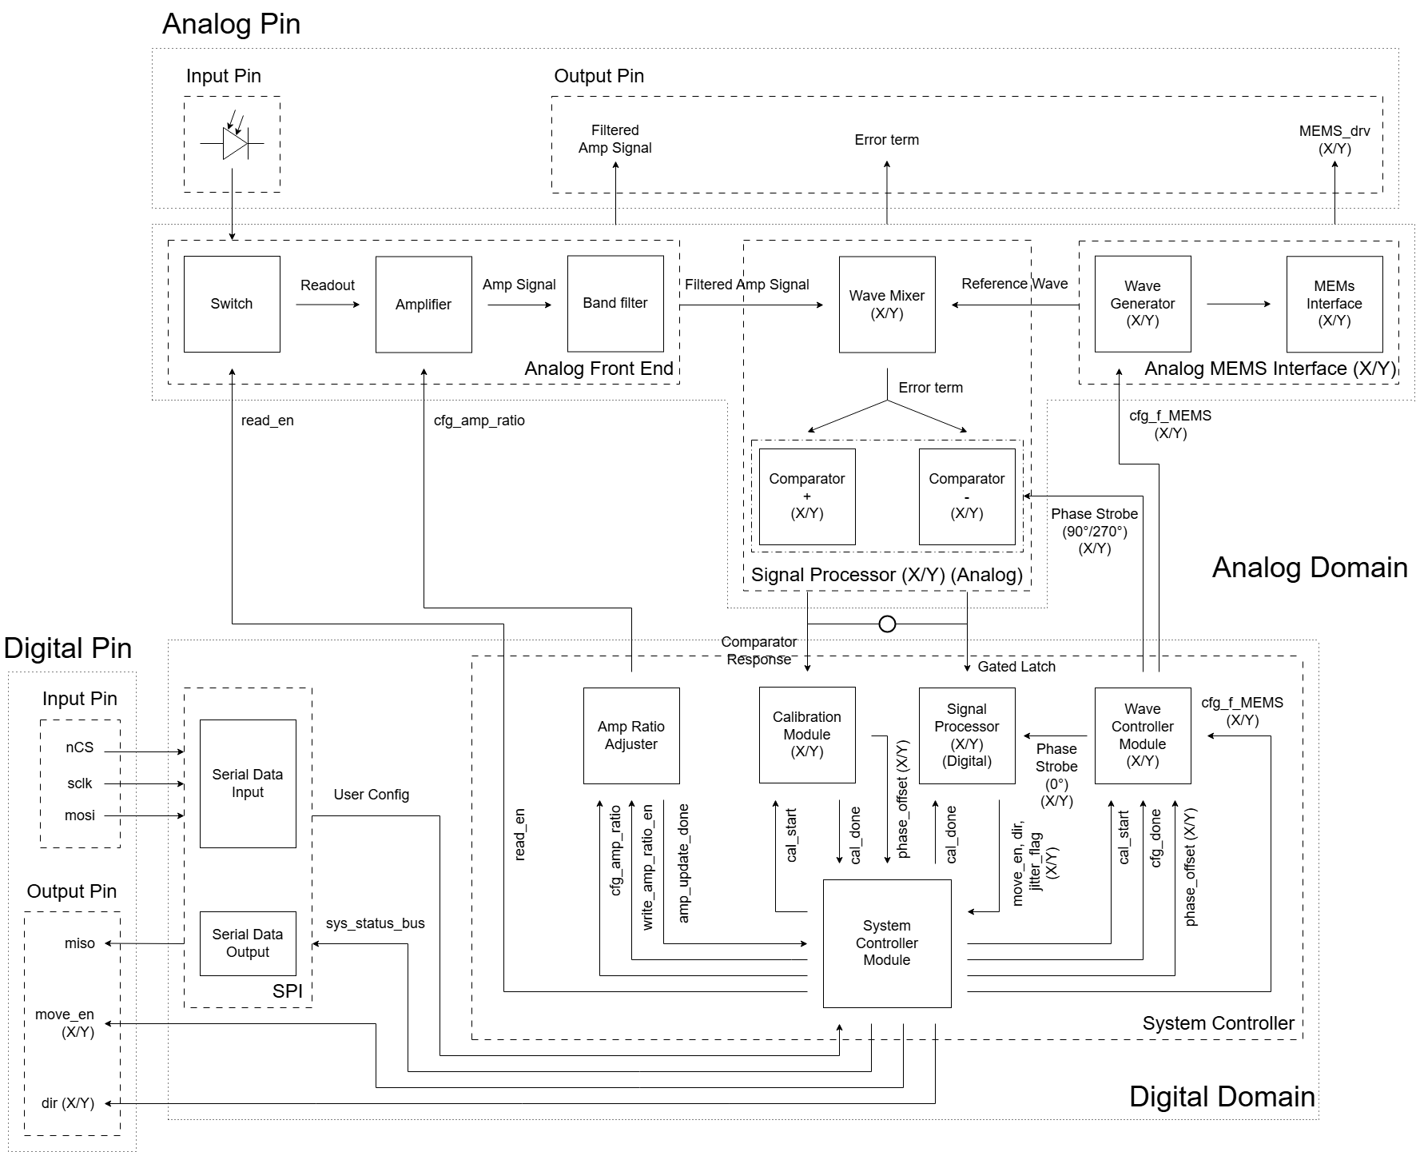
System Overview
State Control Mixed Signal System SPI Interface for Custom Config and Command for interupt Status Report Low latency motorized feedback pin move_en Dir Analog pin for readout

Slide 4
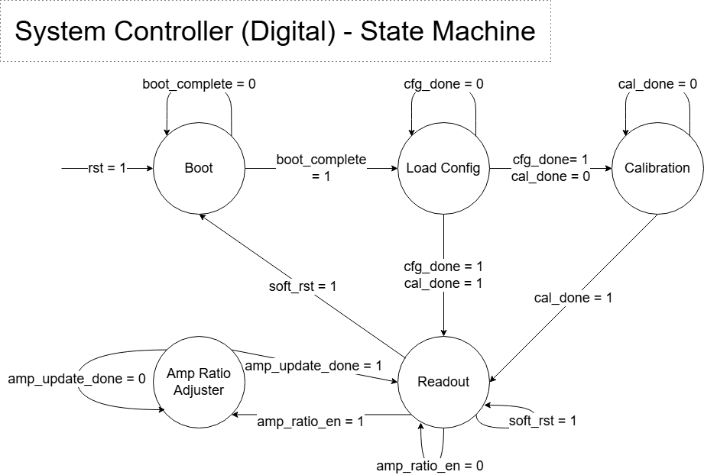
System Overview - State Machine

Slide 5
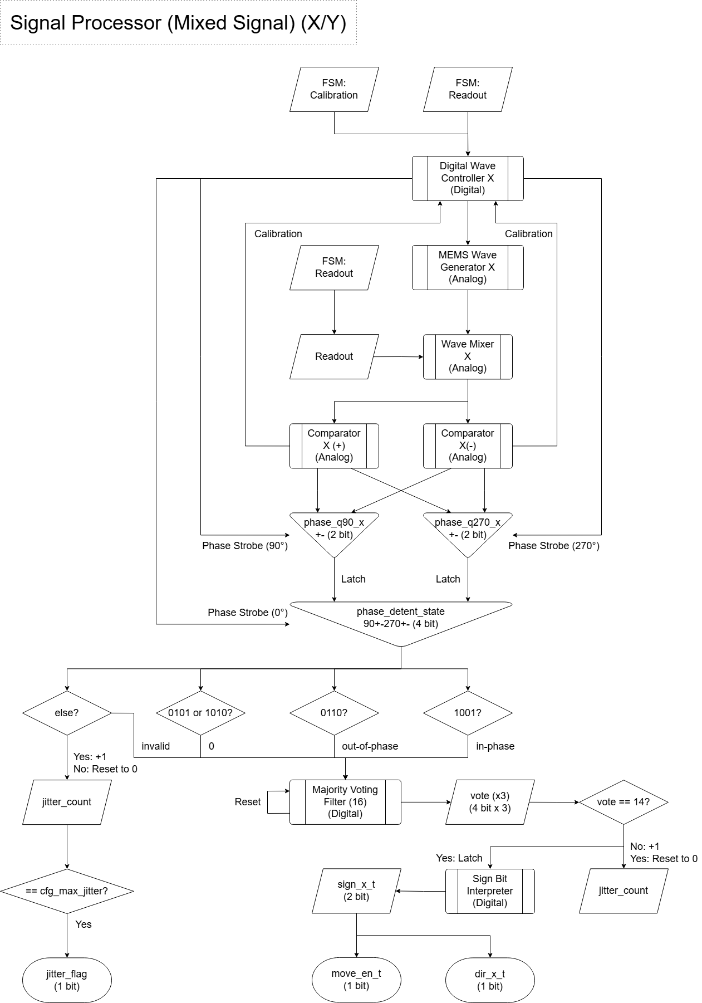
Signal Processor - Analog

Slide 6
Signal Processor - Digital

Slide 7
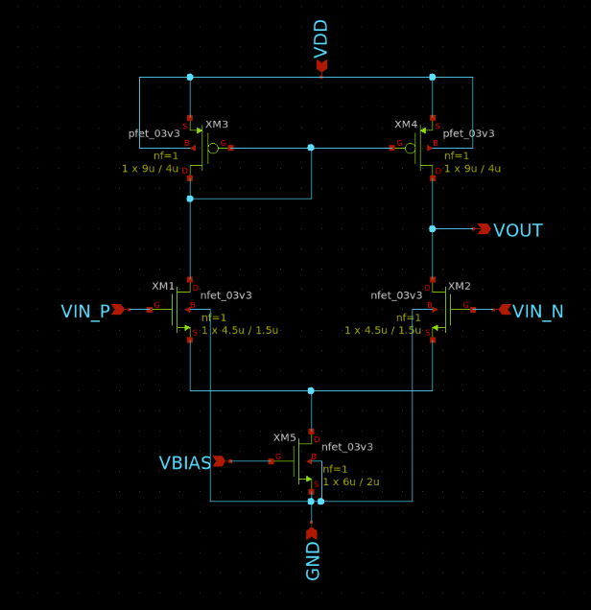
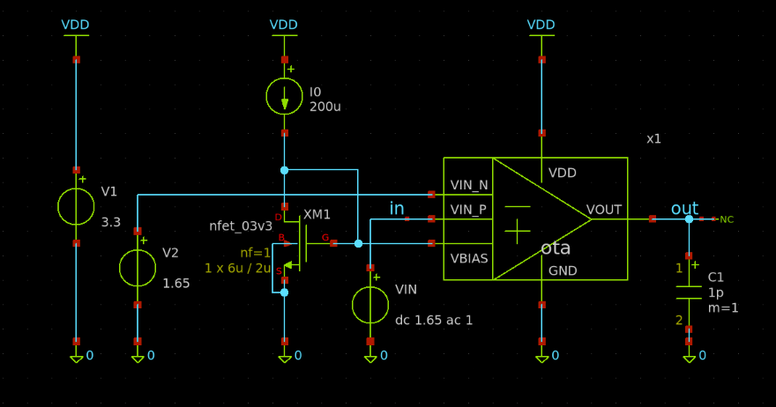
5T Operation Transconductance Amplifier

Slide 8
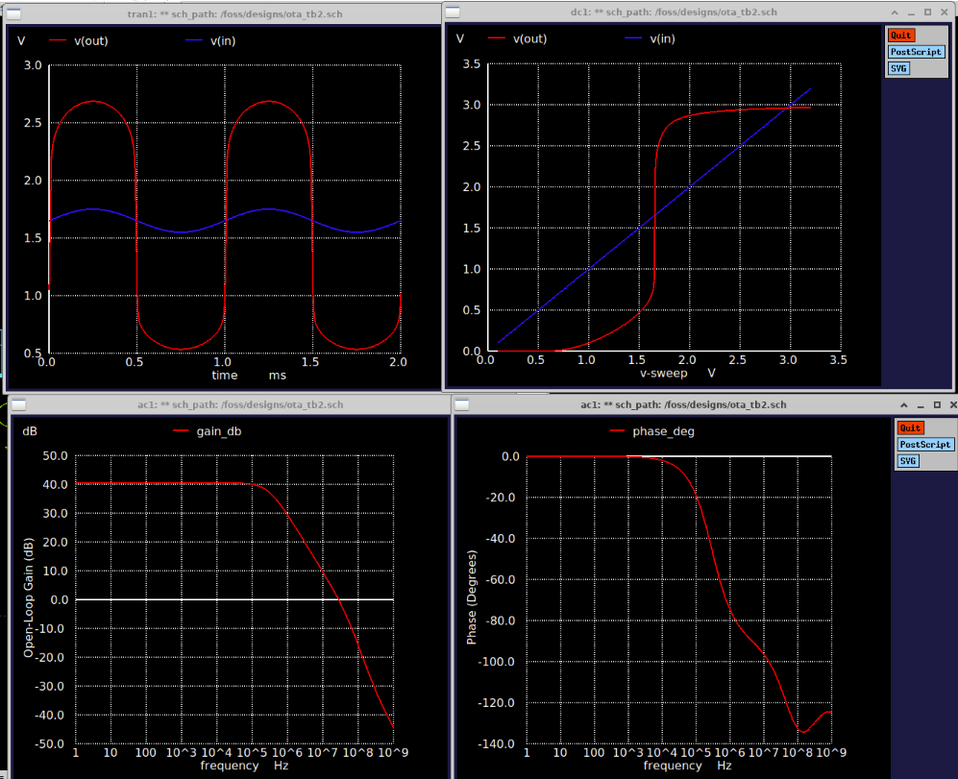
OTA must be tuned more

Slide 9
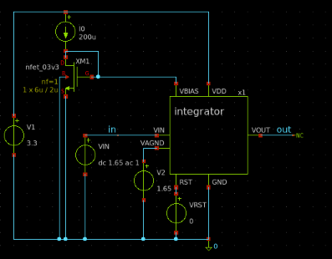
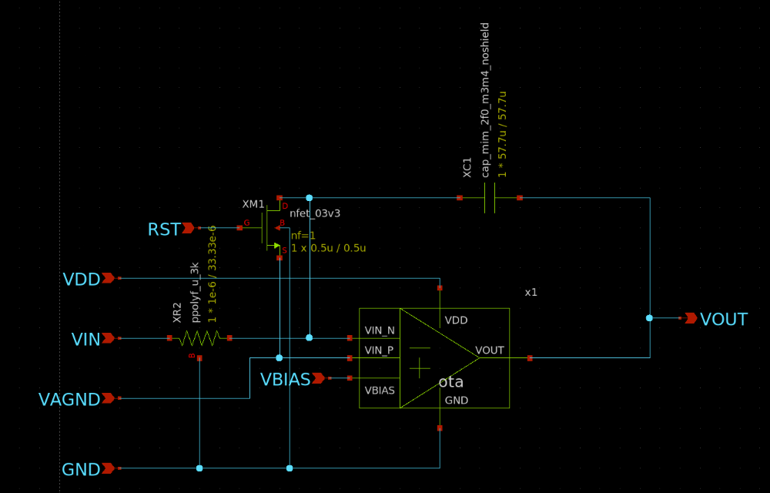
Integrator

Slide 10
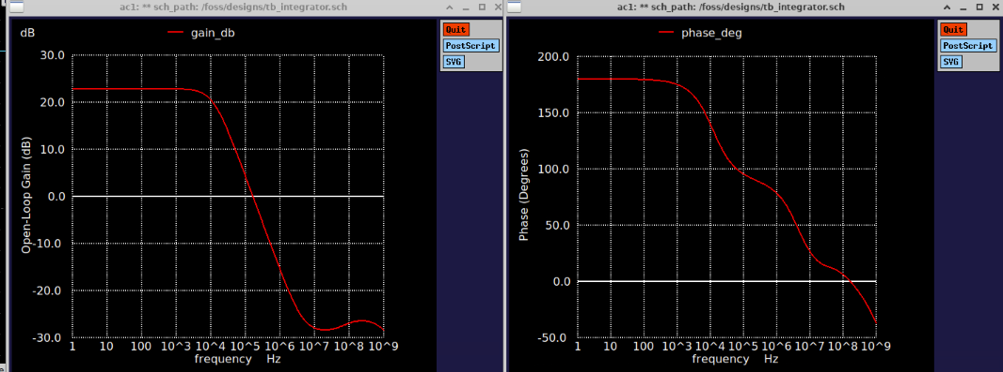
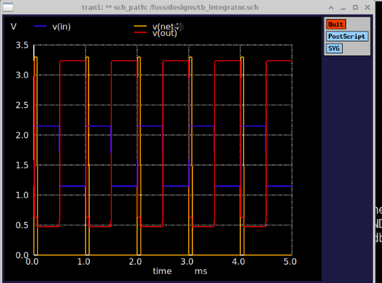
rst

Slide 11
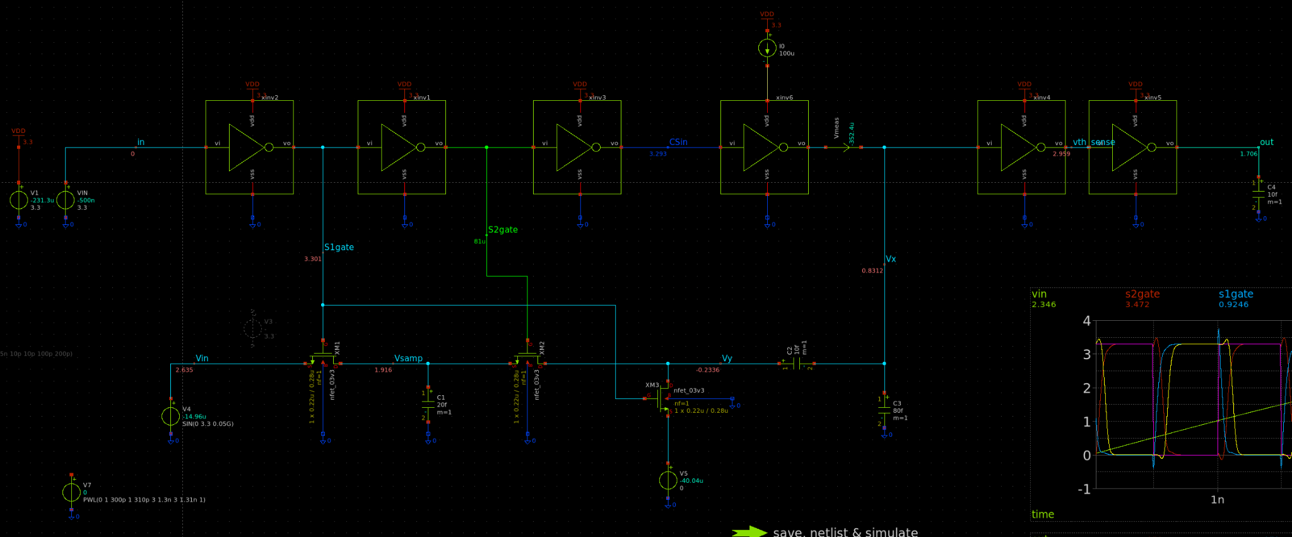
VTC Schematic

Slide 12
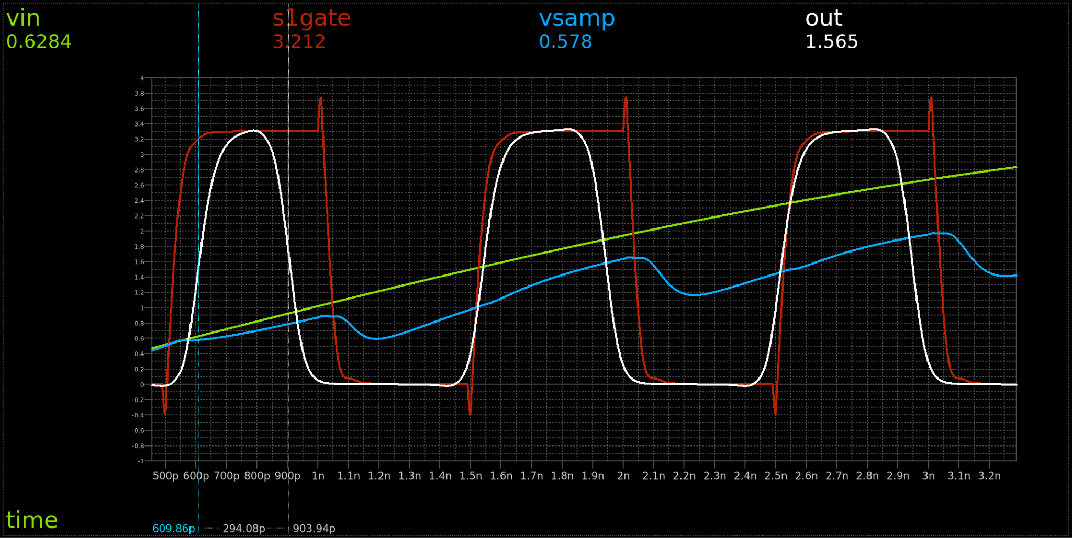
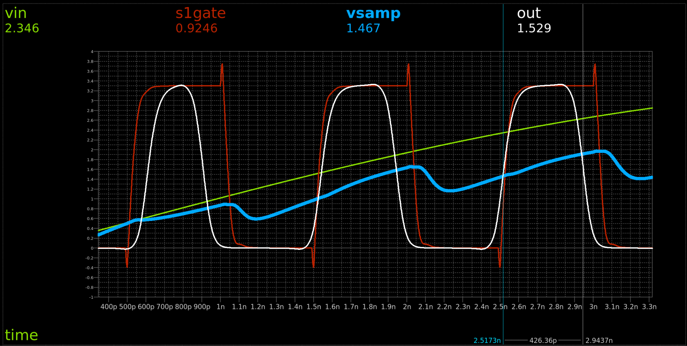
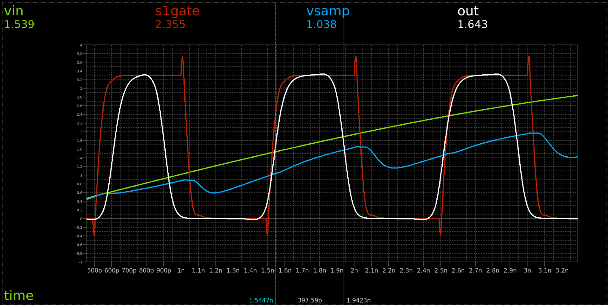
VTC Results
Still need to fine tune delays
Make it more linear
100ps to 30ps pulse widths
Need 256 delays for 8 bit conversion

Slide 13
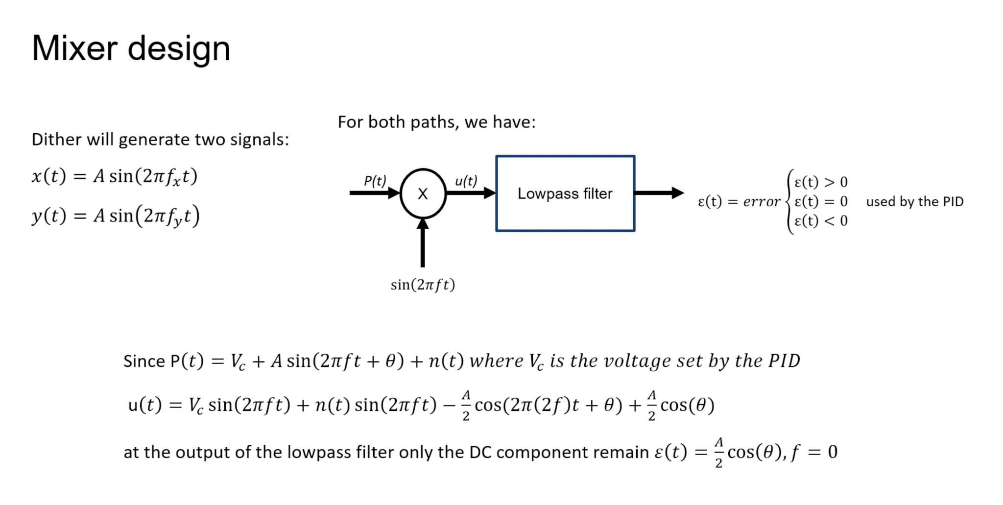

Slide 14
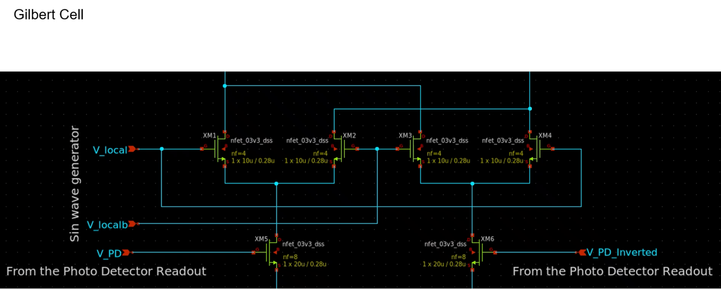

Slide 15
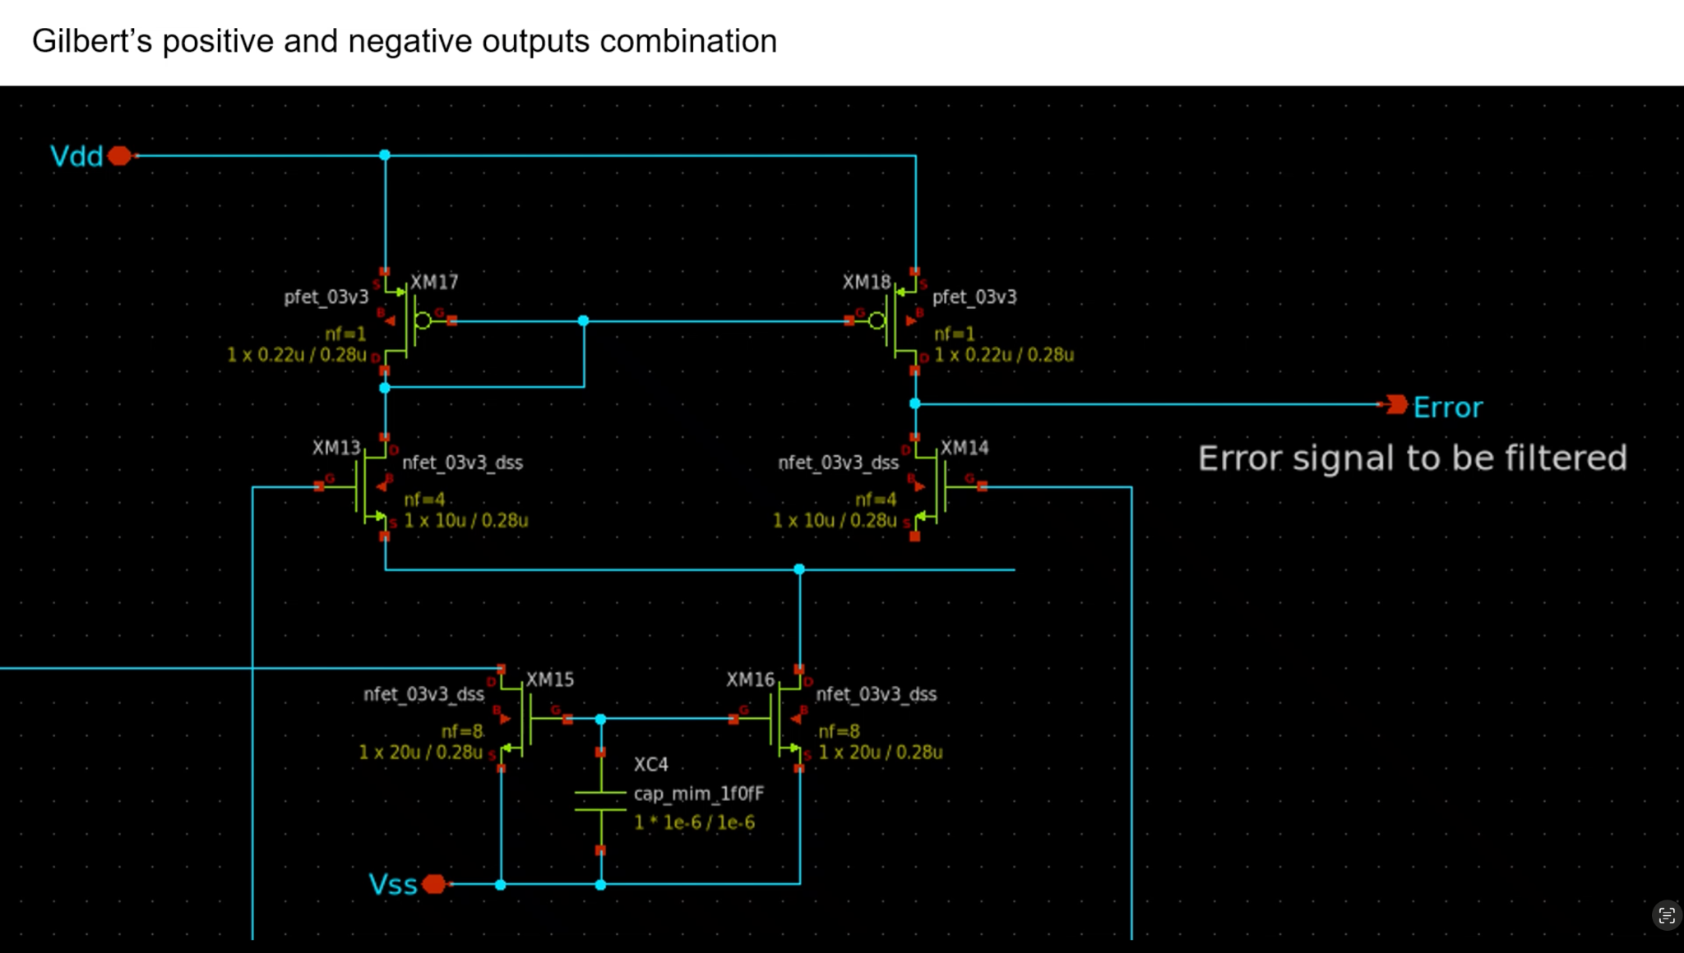

Slide 16
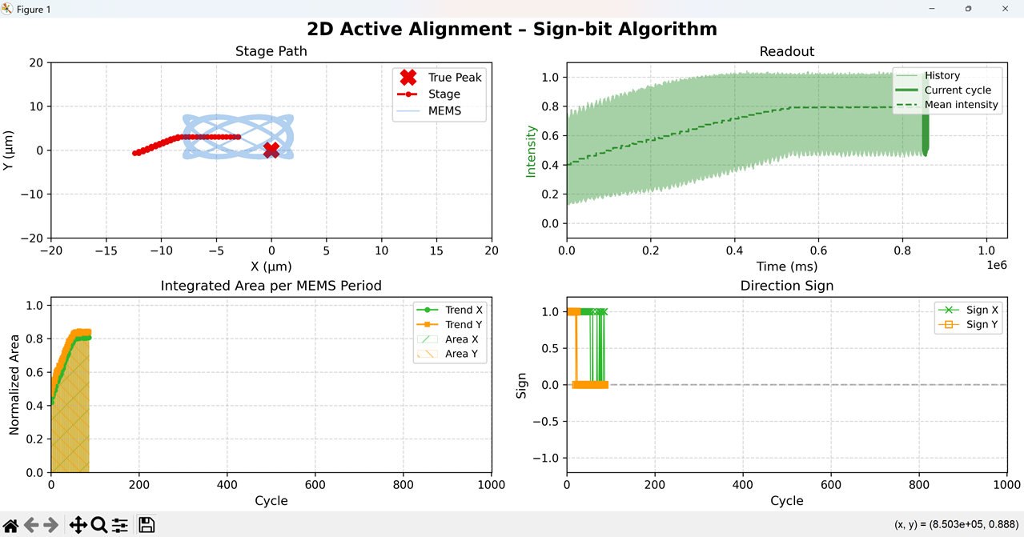
Improvement could be made by voting filter and adjusting amp ratio for better resolution
Simulation Result

Slide 17
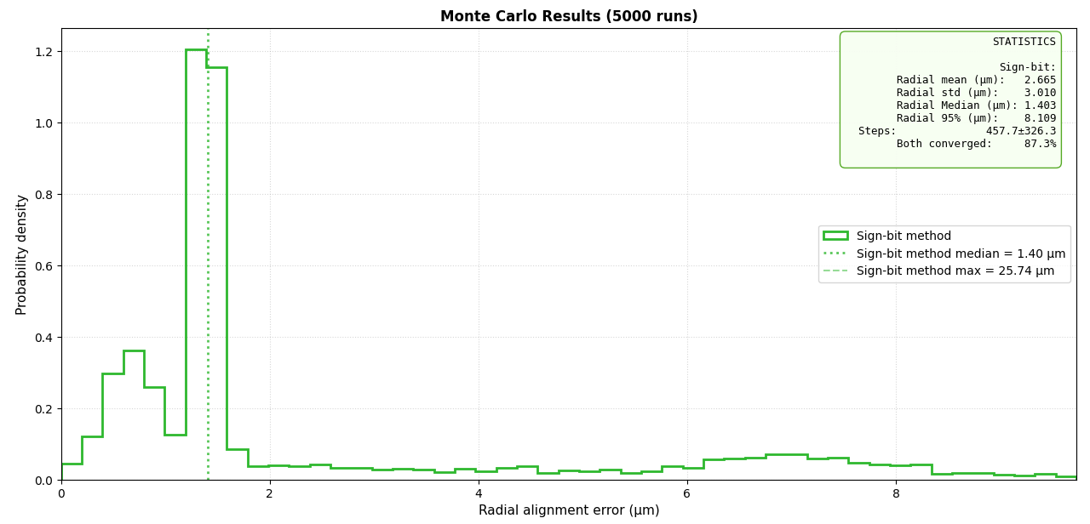
Improvement could be made by voting filter and adjusting amp ratio for better resolution
Simulation Result

Slide 18
Question
1. Should we bundle readout intensity with wave mixer error for synchronous digital reporting, or maintain isolated asynchronous paths in analog?
2. How should we change the amp ratio? Should we use a switch to disable the readout and then change the analog setting?
3. Feedback on the chip architect and state machine?

Slide 19
References
[1]. H.-S. Liao *et al.*, "Low-cost, open-source XYZ nanopositioner for high-precision analytical applications," *HardwareX*, vol. 11, p. e00317, 2022. doi: [10.1016/j.ohx.2022.e00317](https://doi.org/10.1016/j.ohx.2022.e00317)
[2]. W.-M. Wang *et al.*, "Low-voltage and high-performance buzzer-scanner based streamlined atomic force microscope system," *Nanotechnology*, vol. 24, no. 45, p. 455503, Nov. 2013. doi: [10.1088/0957-4484/24/45/455503](https://doi.org/10.1088/0957-4484/24/45/455503)
[3]. Rout, Shasanka Sekhar, et al. "Design of 2.4 GHz Improved Current Reuse Gilbert Mixer with Source Degeneration Technique." Wireless Personal Communications, vol. 122, 2022, pp. 3875–3887, https://doi.org/10.1007/s11277-021-09115-6.
[4]. Altuner, Emre, et al. "High-Linearity Gilbert-Cell Mixer Design for Cryogenic Applications." Analog Integrated Circuits and Signal Processing, vol. 113, 2022, pp. 249–256, https://doi.org/10.1007/s10470-022-02098-9.

